Slide 1
NC Division of Forest Resources: Wildfire Activity and Outlook for Winter / Spring 2011
Paul Gellerstedt, NCFS
24 March 2011

Slide 2
NC Division of Forest Resources – 2011 Wildfire Activity
Period | # Fires* | # Acres*
March 22, 2011 | 53 | 321.6
Month to date | 575 | 2,326.0
Year to date | 2,559 | 14,715.5
10yr avg, Jan-Mar | 2,083 | 9,827.0
10yr avg, 2001-2010 | 4,719 | 25,376.0
* These numbers are preliminary until finalized in the Fire Report System.

Slide 3
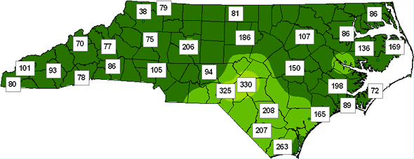
Keetch-Byram Drought Index (KBDI)
March 22, 2011
KBDI is a soil/duff drought index that ranges from 0 (no drought) to 800 (extreme drought) and is based on soil capacity of 8 inches of water. Factors in the index are maximum daily temperature, daily precipitation, antecedent precipitation, and annual precipitation.
Between 0 and 200, soil moisture and large class fuel moistures are high and do not contribute significantly to fire intensity.
Readings of 201-400 are typical of late spring, early growing season. Lower litter and duff layers are drying and beginning to contribute to fire intensity.
Readings of 401-600 are typical of late summer, early fall. Lower litter and duff layers burn intensely.
Readings of 601-800 are associated with severe drought and increased wildfire occurrence. Intense, deep burning fires with significant downwind spotting. Extensive mop-up required. Live fuels burn actively.

Slide 4
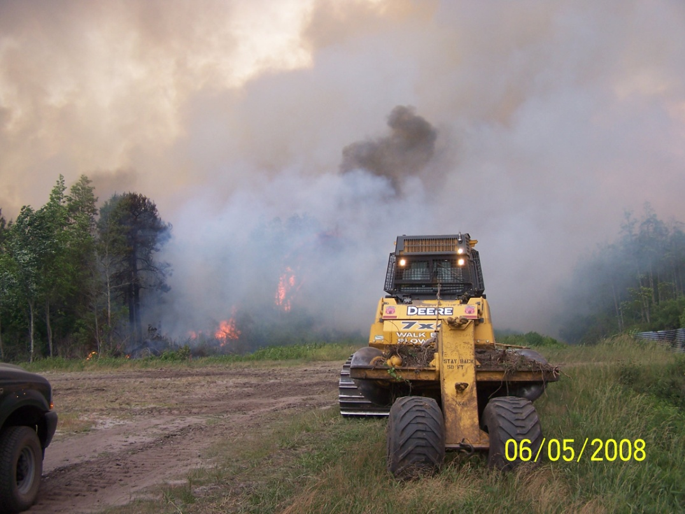
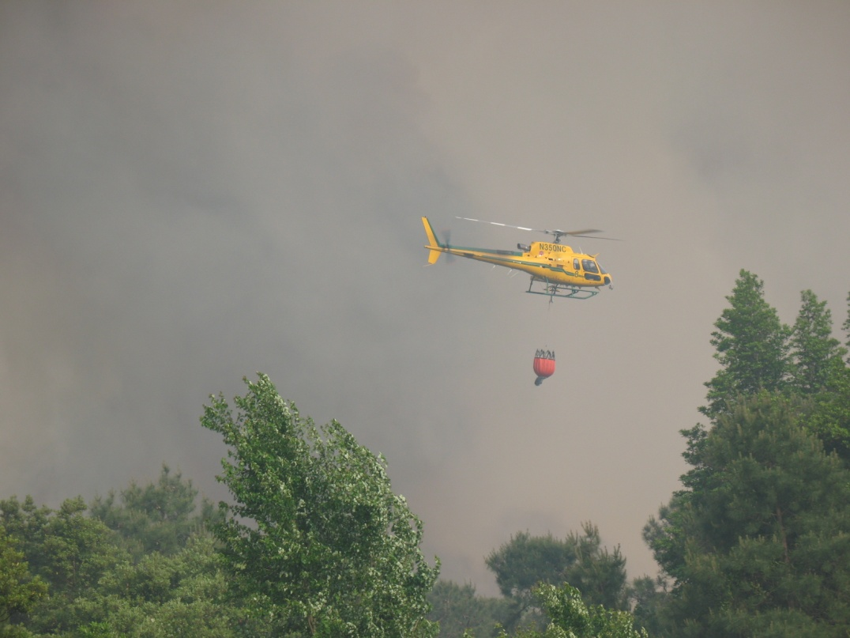
Wildland Fire Outlook – March through June 2011
La Niña: The ongoing La Niña influence is expected to continue well into 2011. This tends to result in drier and warmer than usual weather across the southeast, contributing to increased fire potential.
Drought: Persisting and developing drought across portions of the southeast, this will promote above normal significant fire potential during the spring and summer.
Fuel Dryness: Dryness across the southeast will expand areas of above normal significant fire potential.

Slide 5
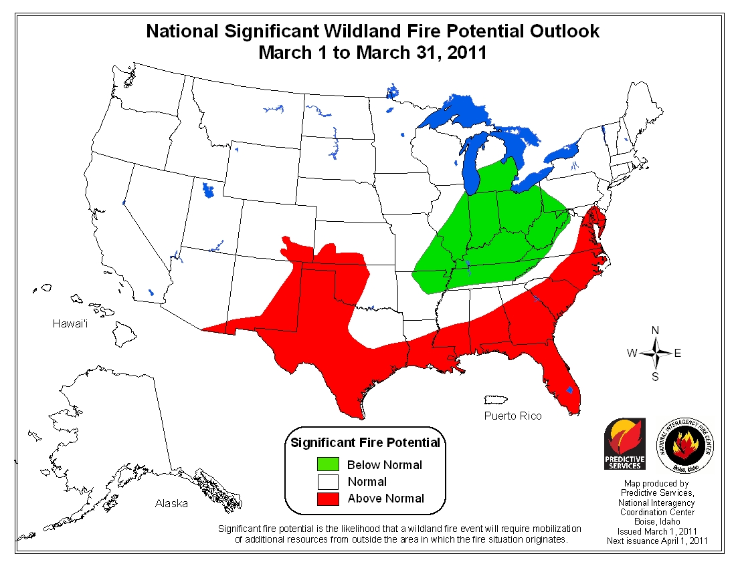

Slide 6
